Slide 1



K-Means Clustering
Goal is to attempt to relate different time intervals to stock volatility through clustering.
Symbols: AIG, AMZN, PEP
Vector Dimensions: Normalized Volume, Symbol Volatility +1 Day, VIX Volatility +1 Day, Time Interval
Time Intervals: Period of Day, Day of Week, Fiscal Quarter, Year
K-means clustering in R and Hadoop with cluster size of 3-4

Slide 2
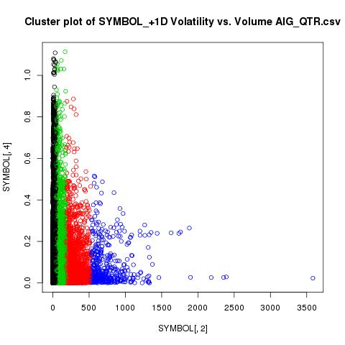
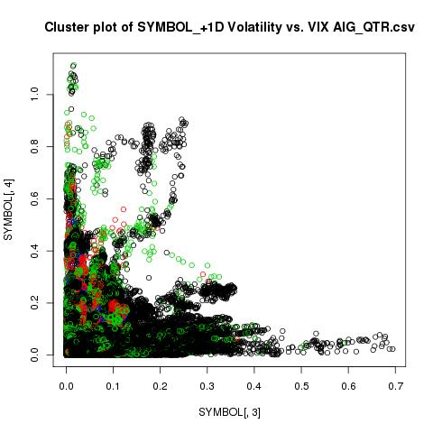
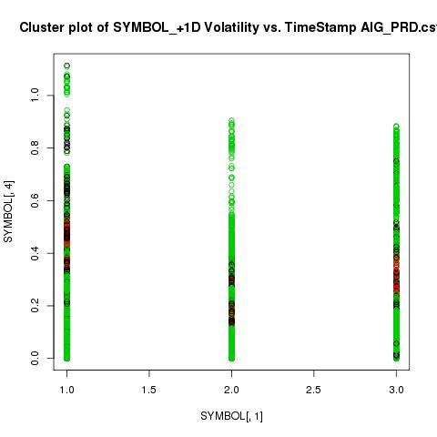
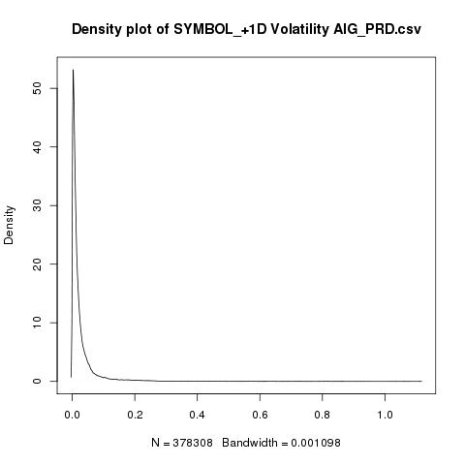
Cluster Results
No strong correlation of time intervals to symbol volatility across all three sectors.
No strong correlation between VIX volatility and symbol volatility.
There is a significant relationship between volume and symbol volatility.

Slide 3
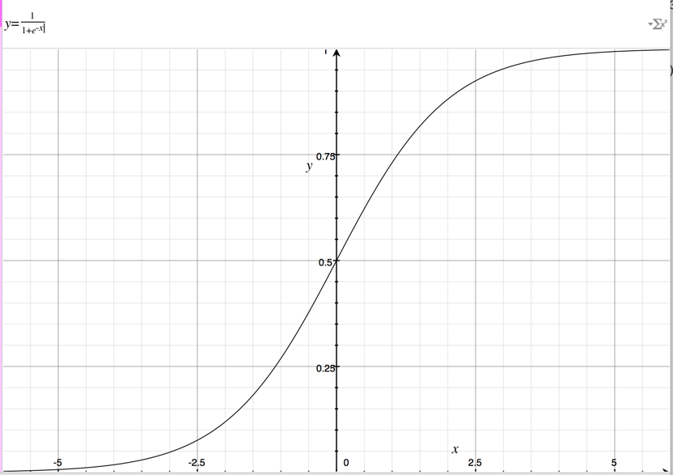
Logistic Regression
Goal is to use classification model to separate variables out during feature selection and identify which ones generate the best predictive power
Symbols: Tested AIG, AMZN, PEP
Parameters in Dataset:
Normalized Volume, Symbol Volatility +1 Day, VIX Volatility +1 Day, Time Interval
Targeted predicting when Symbol Volatility would rise over .25, which is the generally accepted cut off

Slide 4
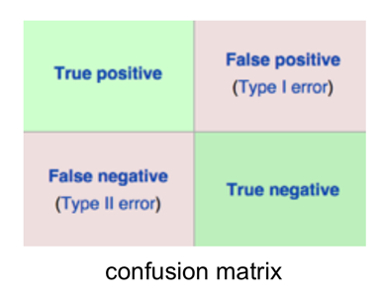
Regression Results
Measured by AUC (Area Under Curve)
1 is a True Positive and 0 is a True Negative, while .5 is completely Random
Little to no relationship with time intervals to symbol volatility, but that may be skewed by market crashes
VIX volatility and symbol volatility are nearly completely randomly related
There is a significant relationship between volume and symbol volatility.

